Slide 1



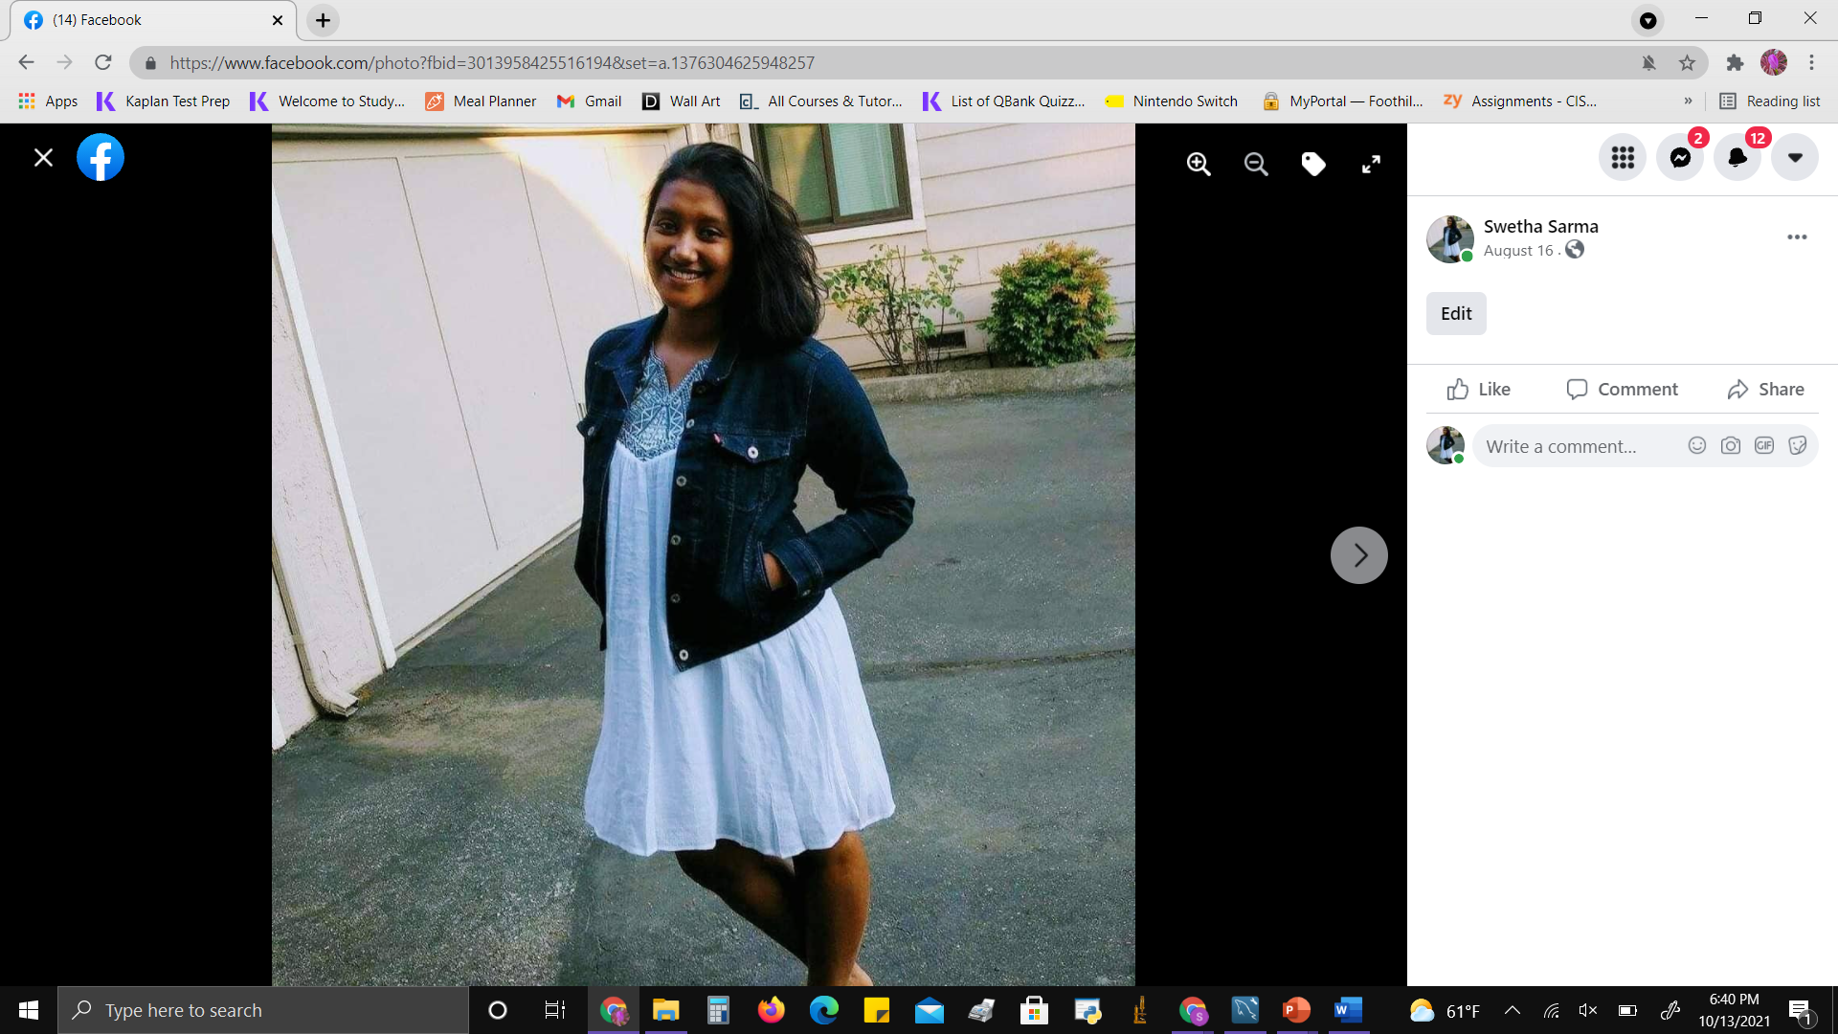
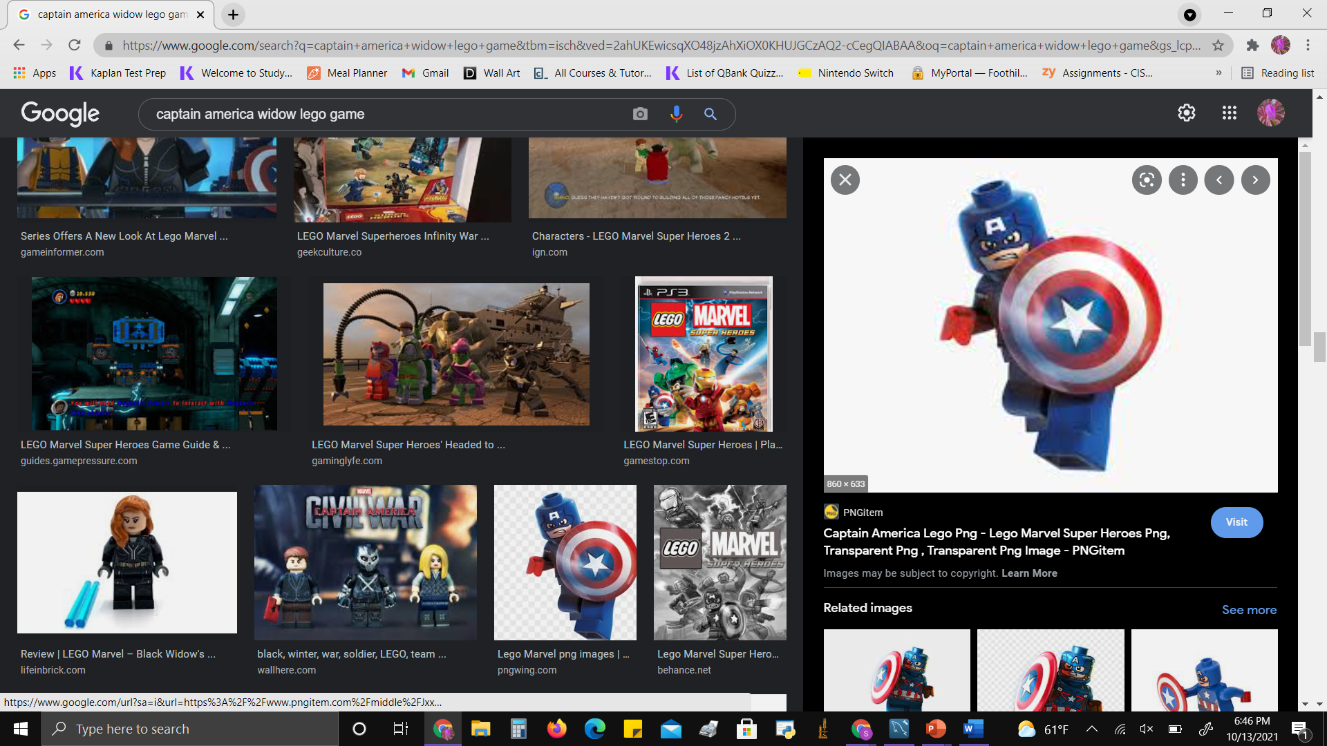





Database System Project: The Avengers VS Hunger
Swetha Sarma, Monisha Gopal, Moumi Kumar, Miloni Gada , and Joyce Tse

Slide 2
Content
Business Scenario
Swim-Lane Diagram
ER Diagram
Create Tables
Triggers
Insert Tables
Business Queries
Visualizations
Conclusion

Slide 3
Attack Plan for Hunger – Customer Enters
It's a beautiful evening on Saturday, December 18th, 2019. Hulk, Tony Stark and Thor have all finished their work for the day and decide to go for a nice birthday dinner for Hulk at 8pm. They decide on Tony's favorite steakhouse in LA called the MooHouse restaurant where they have a reservation. The waiter greets them at the front door and notices Tony, a frequent visitor of the MooHouse. Tony asks for his usual table number five. They get seated at a table and the waiter comes up to them at 8:15pm and they place their order.

Slide 4
Attack Plan for Hunger - Ordering
Hulk being a massive guy decides to order a large order of the Big Texan which is 4.5 pound of steak for $72. Thor is trying to watch his figure, so tries to go for a healthy option, the Salmon for $30. Tony wonders why Thor orders a salmon at a steakhouse but understands that after his breakup with Jane things have been rough and decides not to ask. Lastly, Tony being the multi billionaire that he is, goes for the most expensive cut of steak the Wagyu beef for $230. They decide to order bougie champagne to celebrate Hulk’s milestone of turning fifty and orders the fanciest kind, for $250.
Waiter takes the order and inputs the data into the point of sales system for the MooHouse. He creates a tab for the customers at 8:25pm. Once the tab is created the waiter takes the order to the kitchen for the meal to be prepared. The order comes out by 8:45pm. The waiter brings the order to table five and the waiter leaves.

Slide 5
Attack Plan for Hunger – Meal Ends
At the end of the meal the waiter comes back with the check at 9:20pm and given that Thor does not carry money since he is from Asgard and Hulk left his wallet at home in his other set of pants, Tony decides to pay the bill. He decides that he will use his platinum credit card (plus the points are super helpful for buying another arc reactor) and tips his favorite waiter a little above 30%. The total with food, tip and tax is $815.84. Then they head off to the birthday afterparty at Captain America’s.

Slide 6
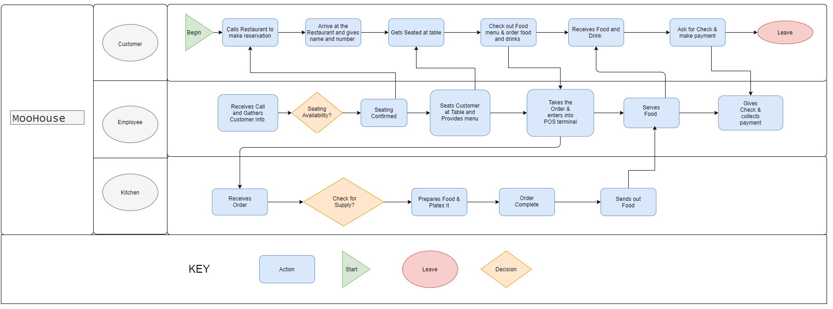
Swim Lane Diagram - MooHouse

Slide 7
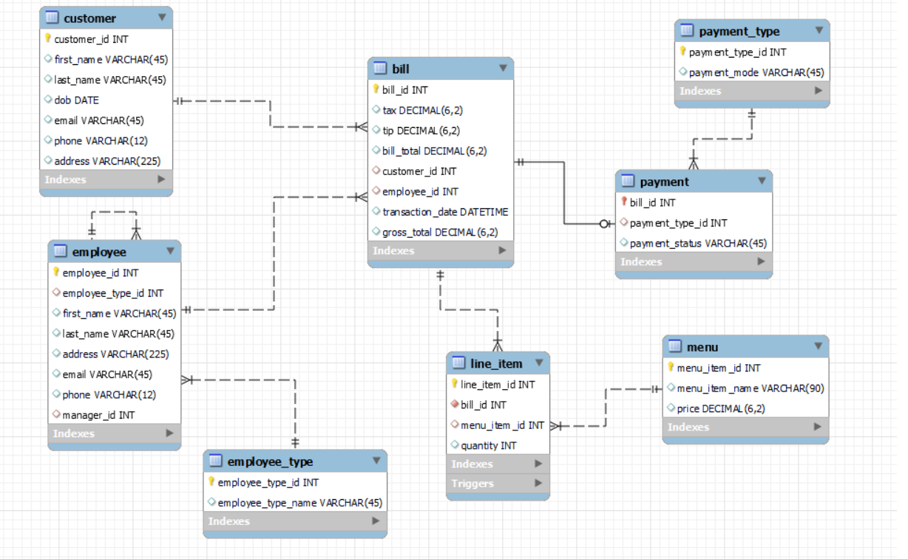
ER Diagram - MooHouse

Slide 8
Creating the Database

Slide 9
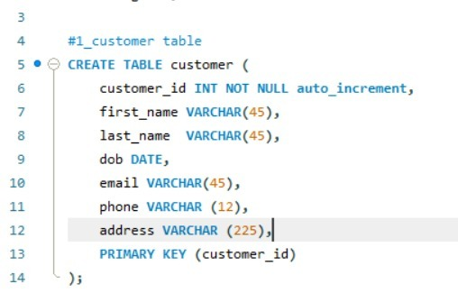
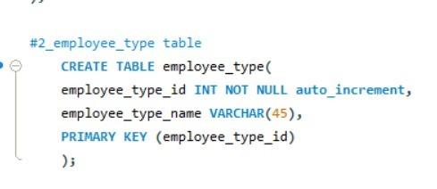
Create Tables
#1 Customer Table
#2 Employee_type Table

Slide 10
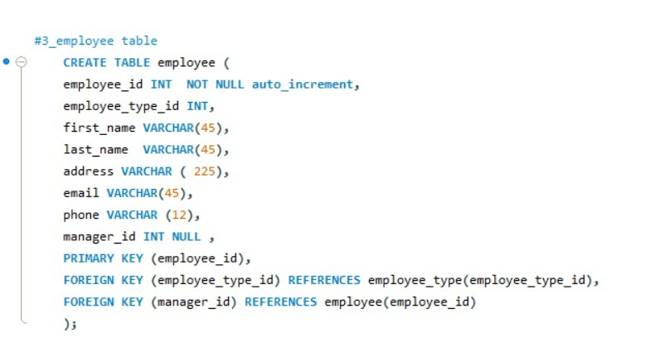
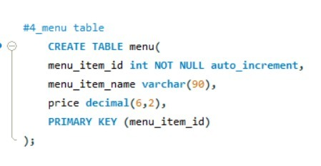
Create Tables
#3 Employee Table
#4 Menu Table

Slide 11
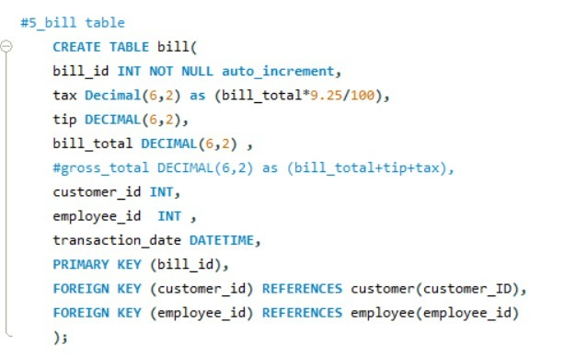
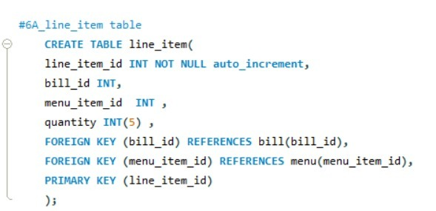
Create Tables
#5 Bill Table
#6A Line_Item Table

Slide 12
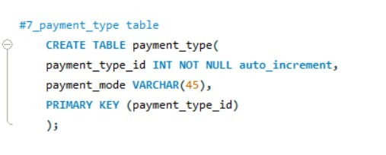
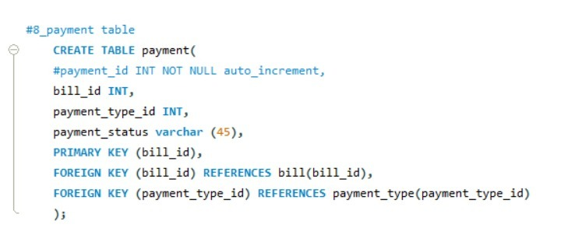
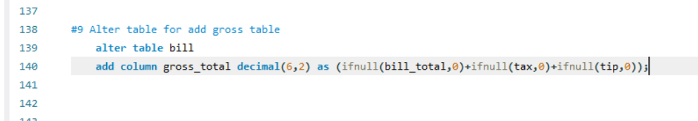
Create Tables
#7 Payment_Type Table
#8 Payment Table
#9 Alter Table Bill after Creation

Slide 13
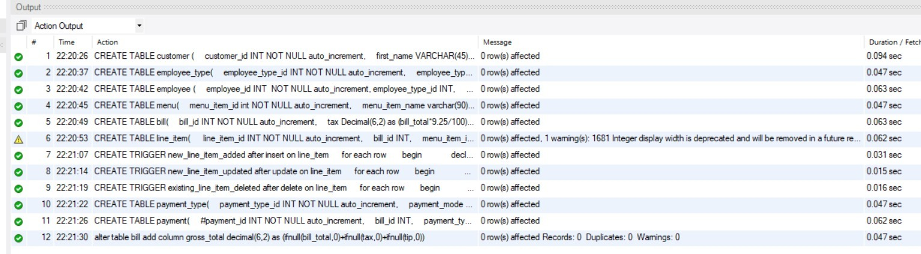
Successful Creation

Slide 14
Triggers

Slide 15
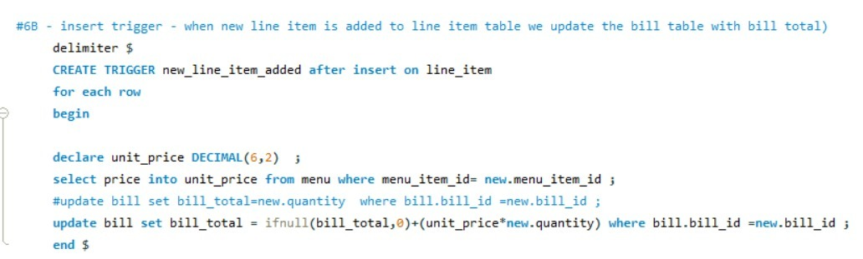
Trigger- Insert
#6B Insert Trigger

Slide 16
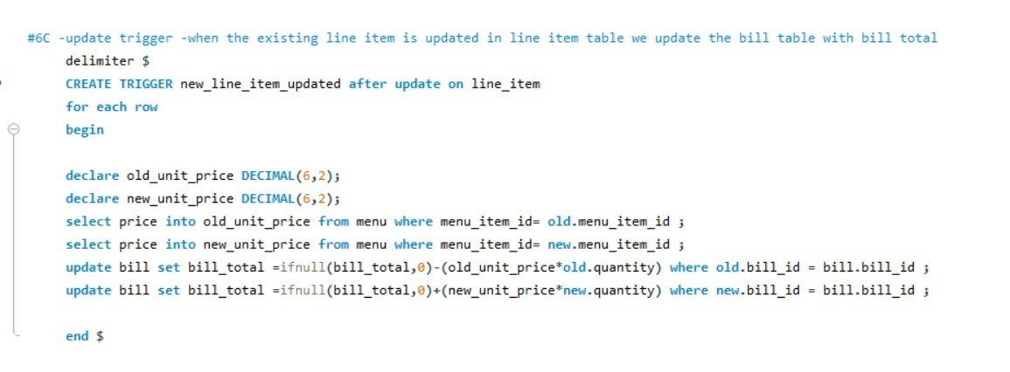
Trigger Update
#6C Update Trigger

Slide 17
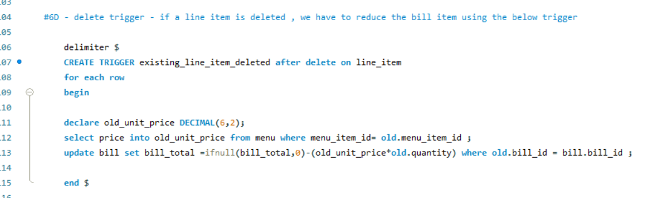
Trigger Delete
#6D Delete Trigger

Slide 18
Insert into the Database

Slide 19
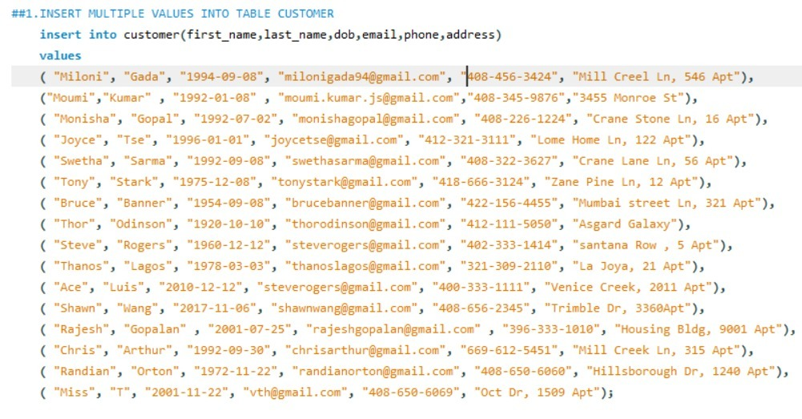
Insert Data – Customer Table

Slide 20
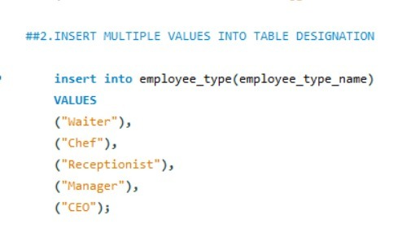
Insert Data- Employee type table

Slide 21
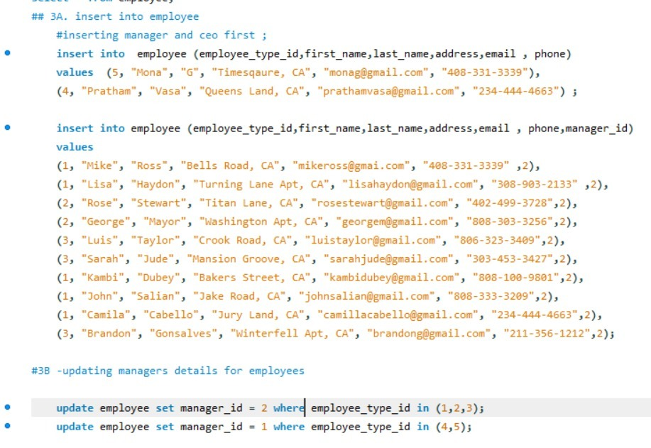
Insert Data – Employee Table

Slide 22
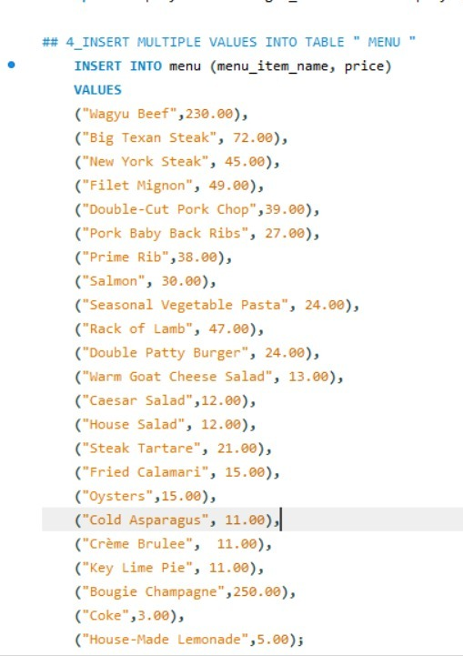
Insert Data – Menu Table

Slide 23
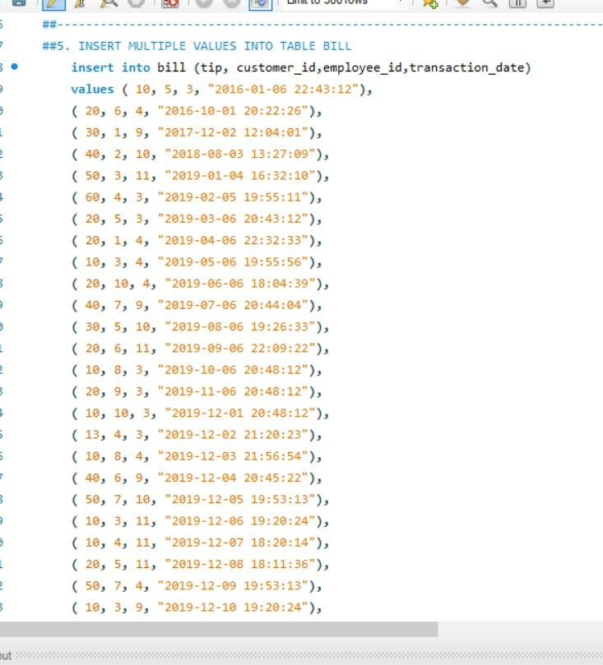
Insert Data – Bill Table

Slide 24
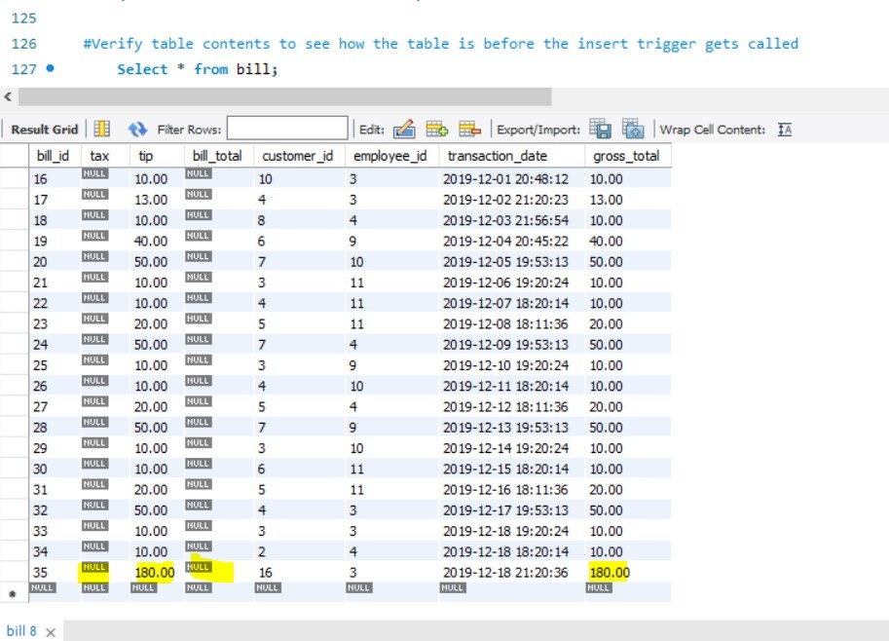
Insert Data – Bill Table Before Line_item table insertion

Slide 25
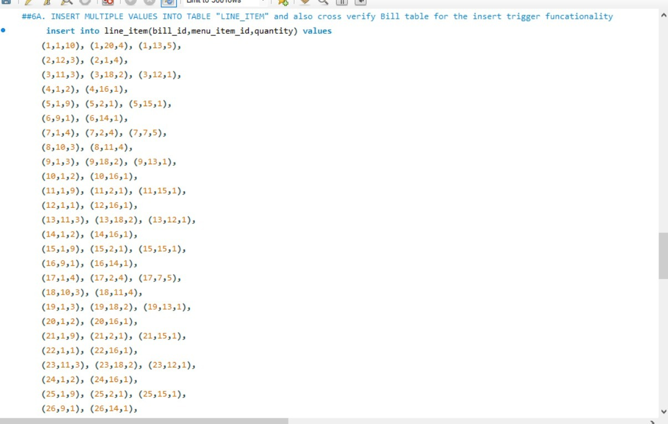
Insert Data – Line_Item Table

Slide 26
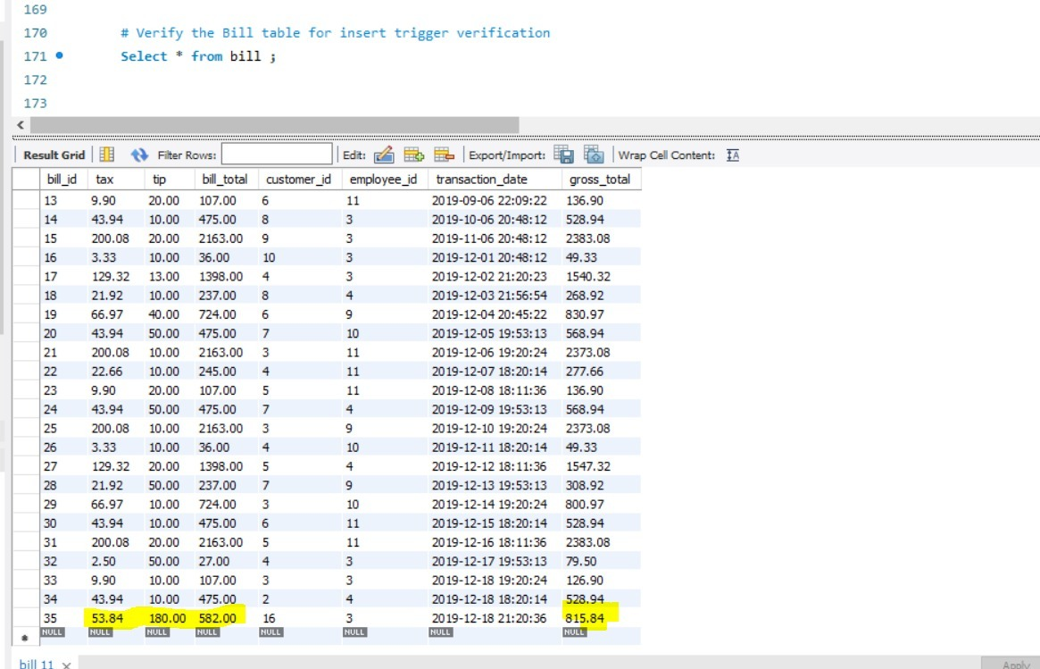
Verify Data – Bill Table After Line_item table insertion

Slide 27
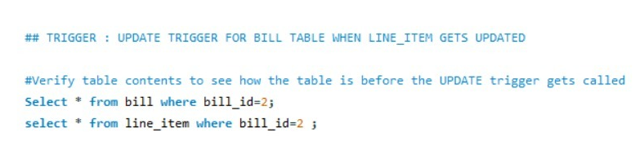
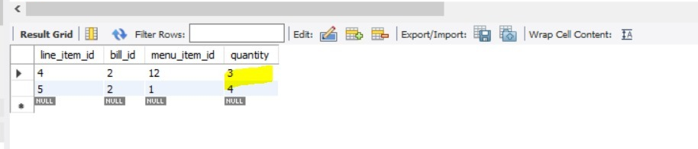
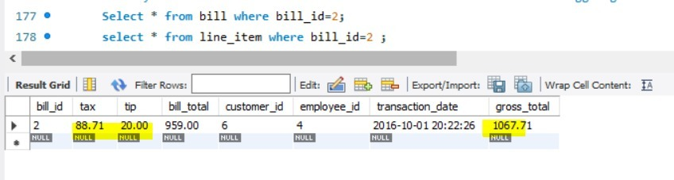
Before the Update Trigger

Slide 28
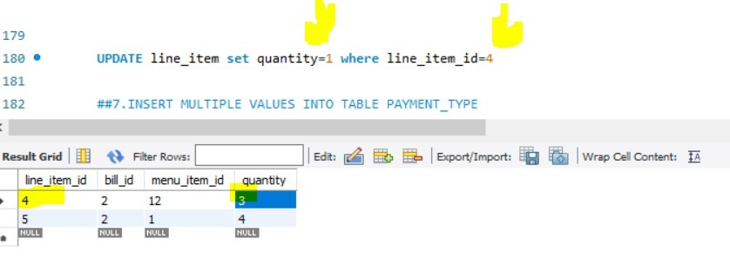
Updating the Quantity of Food & verifying the corresponding update trigger

Slide 29
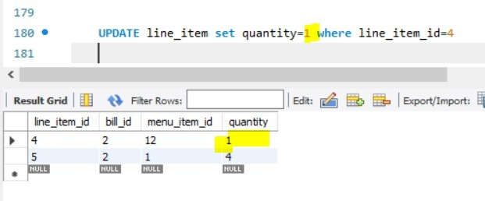
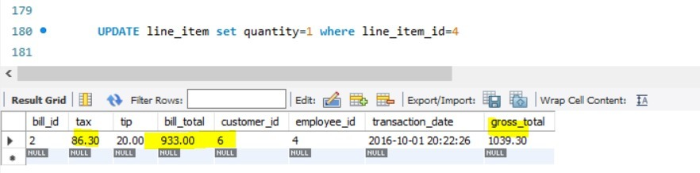
After Update Trigger

Slide 30
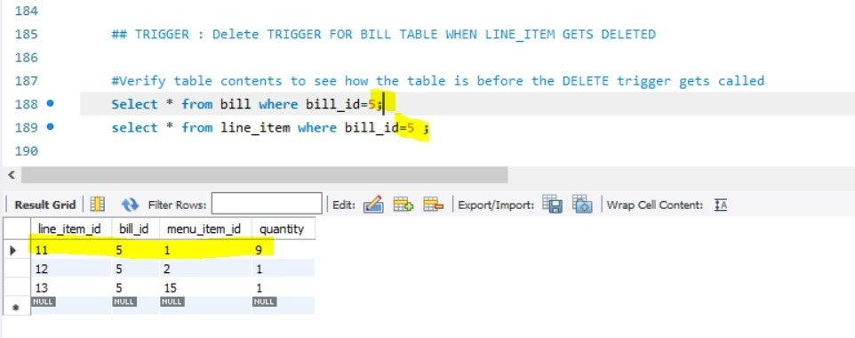
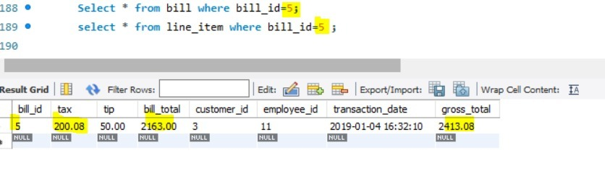
Before Delete Trigger

Slide 31
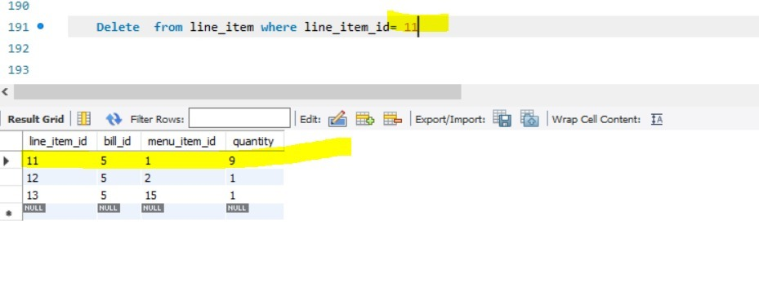
Delete

Slide 32
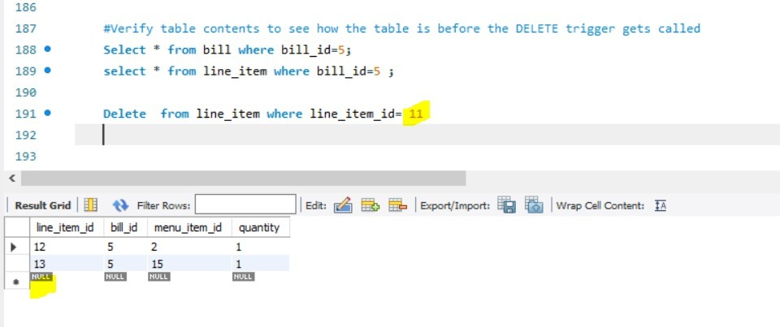
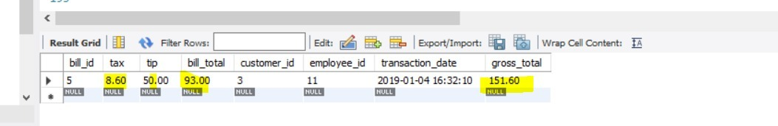
After Delete Trigger

Slide 33
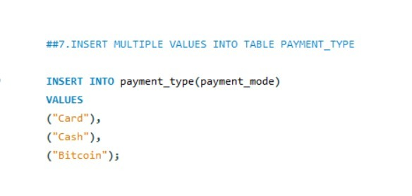
Insert Data – Payment_Type Table

Slide 34
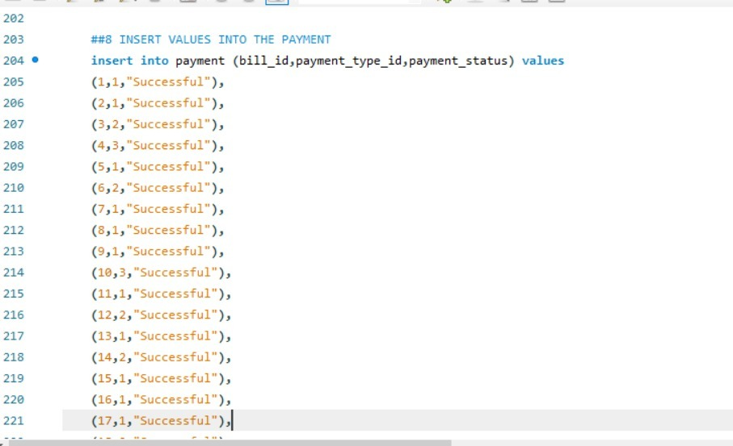
Insert Data – Payment Table

Slide 35
Business Queries
What Business Questions to Extract information from the Database?

Slide 36
Joins

Slide 37
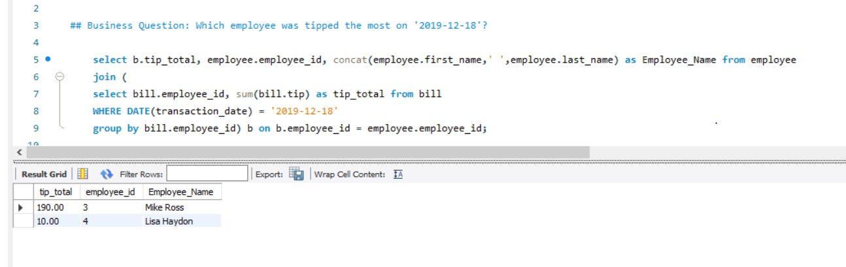
Queries - Join
Business Question: Which employee was tipped the most on ‘2019-12-18’?

Slide 38
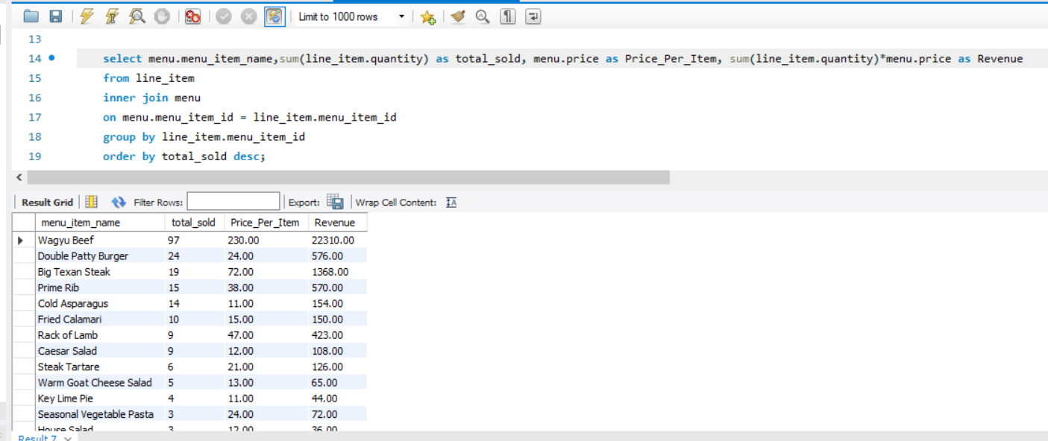
Queries - Inner Join
Business Question: What is the most popular item bought at the restaurant?

Slide 39
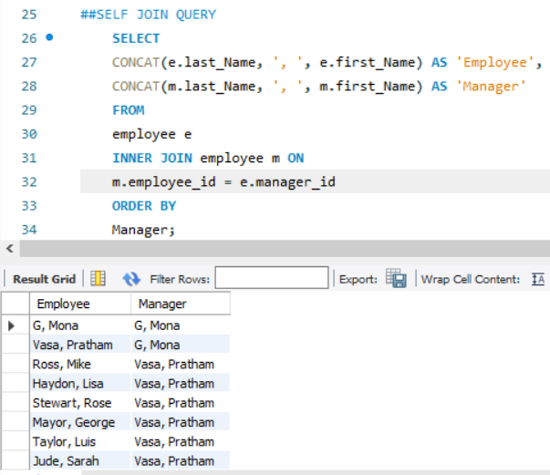
Queries- Self-Join
Business Question: An employee needs to be replaced and we need to figure out which manager he reports to in order for them to hire their employee.

Slide 40
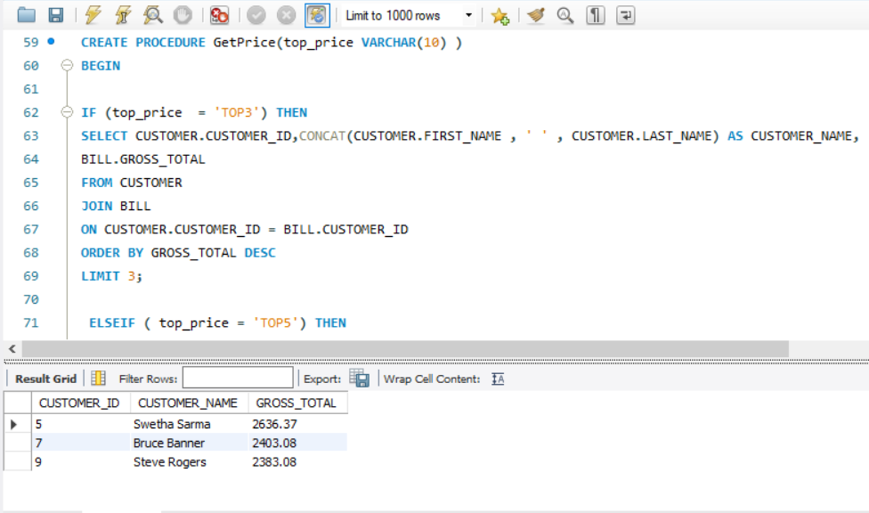
Queries - Procedure
Business Question: Who are the top three customers with the highest bill amount ?

Slide 41
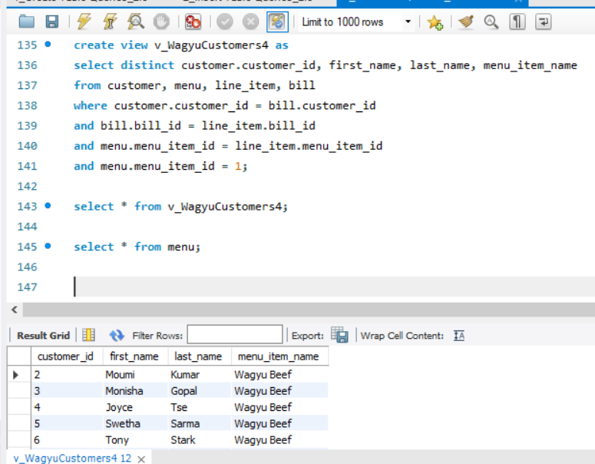
View – list of customer who ordered Wagyu Beef (most expensive food)?

Slide 42
Visualizations of Data

Slide 43
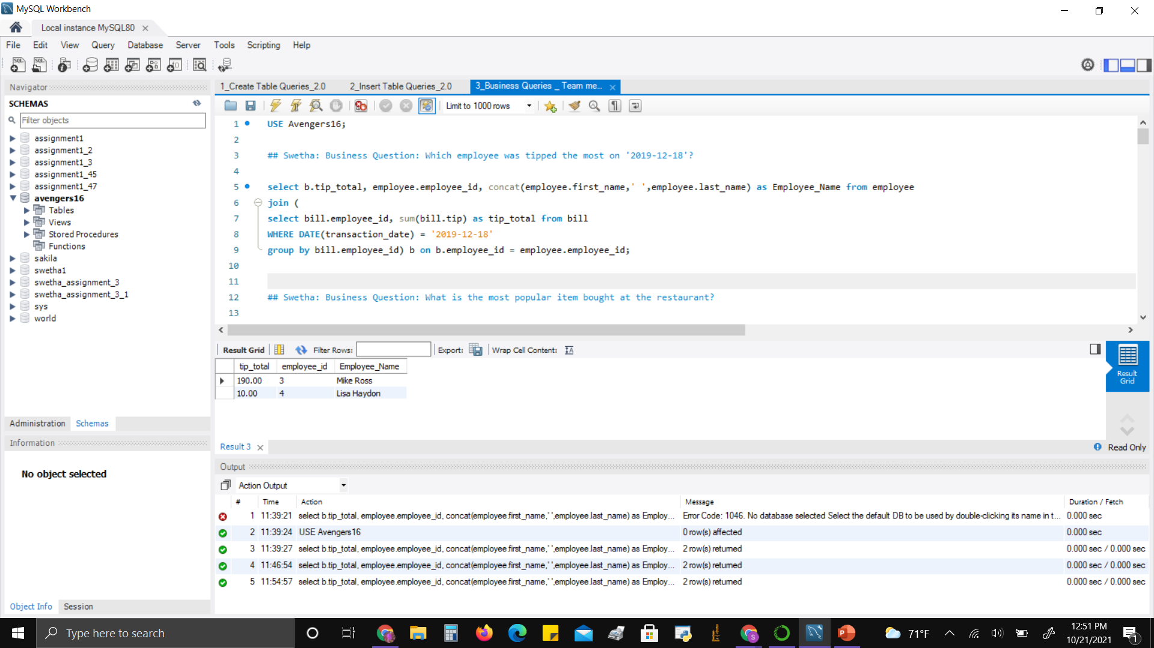
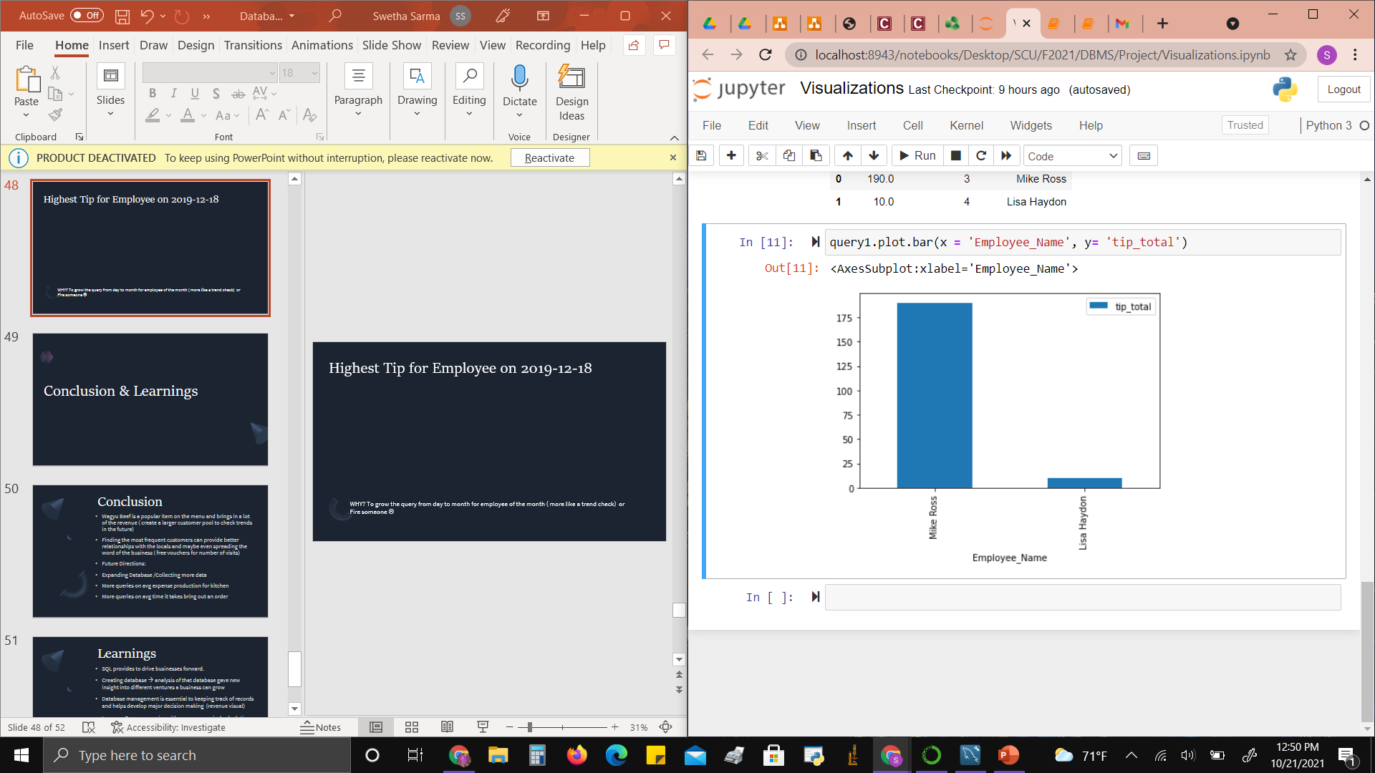
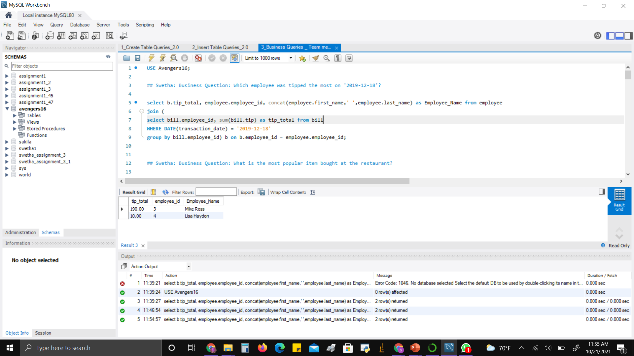
Highest Tip for Employee on 2019-12-18
WHY? Comparing Employee Performance ! ( incase you need to let go of someone)

Slide 44
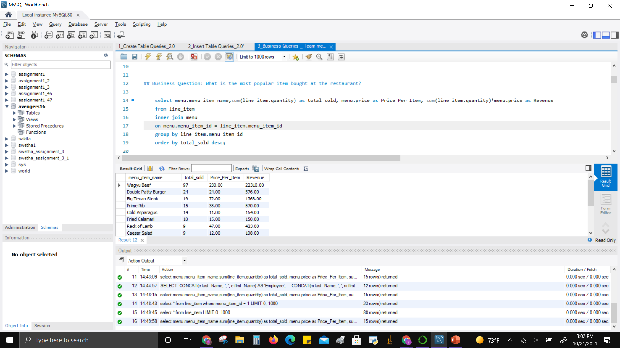
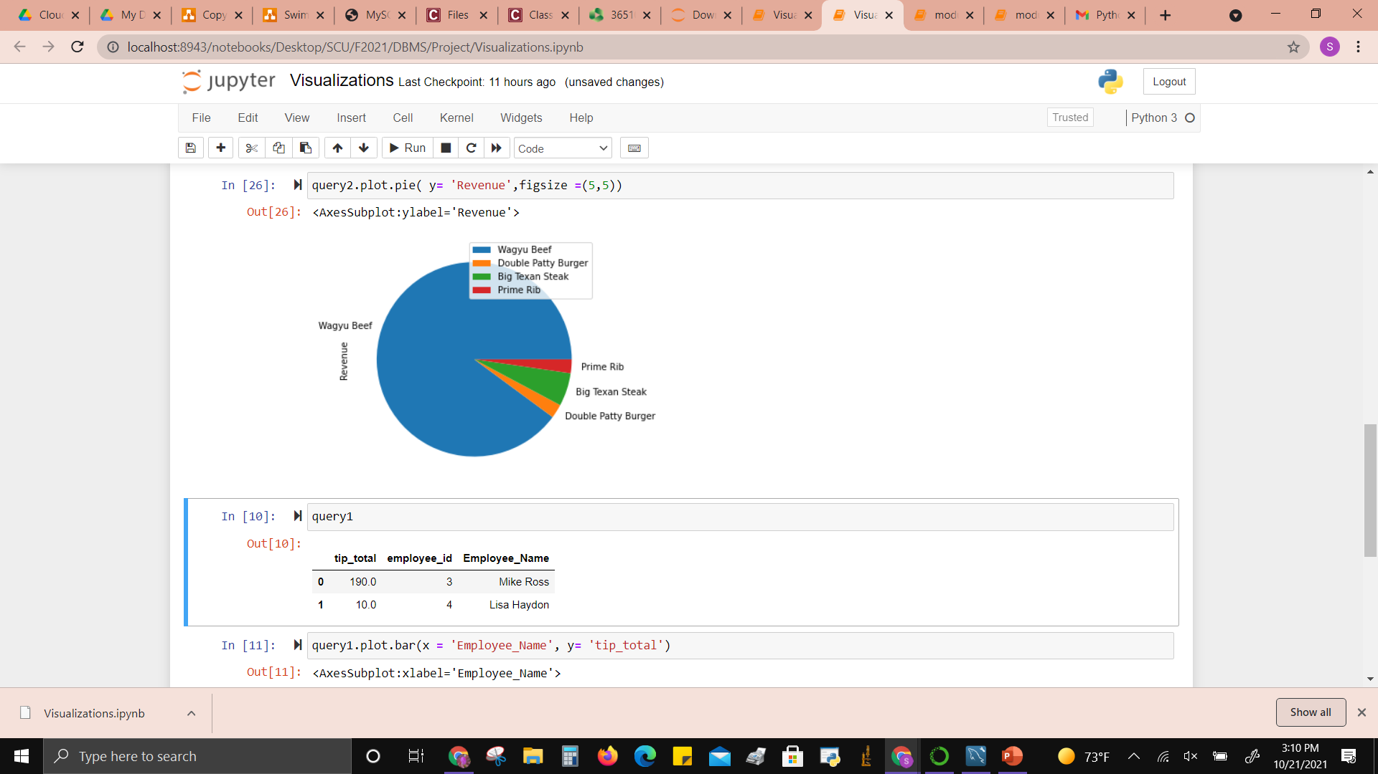
Revenue from Menu Items
WHY? To understand the most popular item in demand to keep in stock.

Slide 45
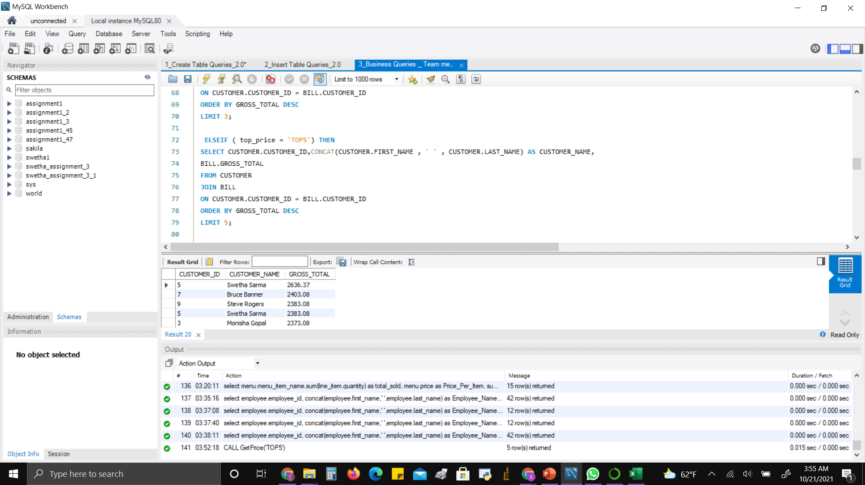
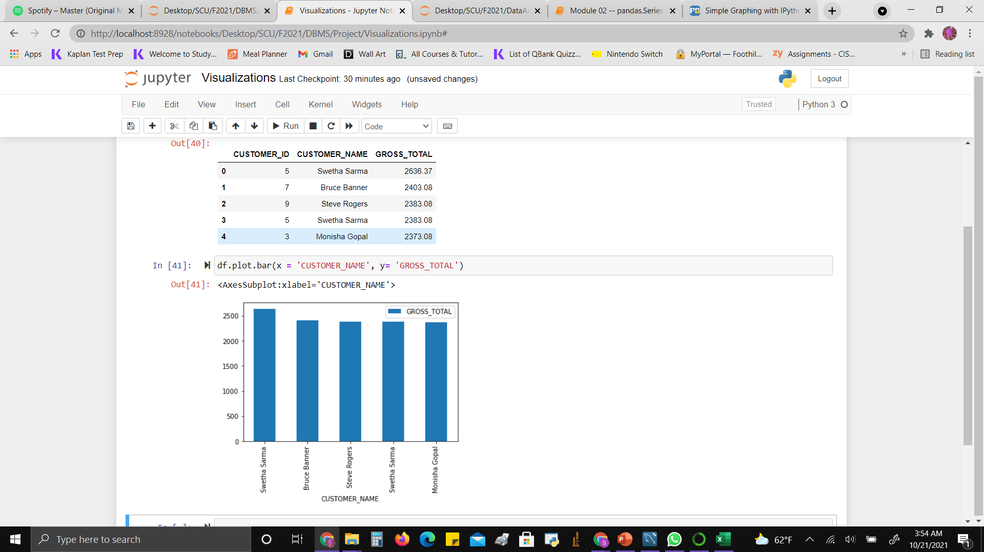
Top Five Customers based on Gross Total Income
WHY? To gift a special voucher for being a loyal customer (increase client business relationship)

Slide 46
Conclusion & Learnings

Slide 47
Conclusion
Wagyu Beef is a popular item on the menu and brings in a lot of the revenue ( create a larger customer pool to check trends in the future)
Finding the most frequent customers can provide better relationships with the locals and maybe even spreading the word of the business ( free vouchers for number of visits)
Future Directions:
Expanding Database /Collecting more data
More queries on avg expense production for kitchen
More queries on avg time it takes bring out an order

Slide 48
Learnings
SQL provides to drive businesses forward.
Creating database → analysis of that database gave new insight into different ventures a business can grow
Database management is essential to keeping track of records and helps develop major decision making (revenue visual)
Improve: Do more queries with more economical calculations to determine the employee of the month
Maybe also include a incentive/bonus for proper working employees how would that effect my database?

Slide 49
Thank You
Hunger has been Avenged!

